Slide 1
Physiology of the female sexual cycle
Prof. Deepthi de Silva
Department of Physiology
Faculty of Medicine
Ragama

Slide 2
At the end of these lectures you should be able to
Describe the follicular, ovulation & luteal phases in the ovary during the female menstrual cycle
Calculate the duration of each phase
Outline the events occurring in the uterus (menstruation, proliferation and secretory phases) & state the relationship between ovarian and uterine phases
Using a clearly labeled diagram, explain the hormonal changes that occur during each phase including the events leading to ovulation
Outline the role of oestrogen and progesterone on the endometrium, myometrium, cervix, vagina, breast and the systemic effects of oestrogens

Slide 3
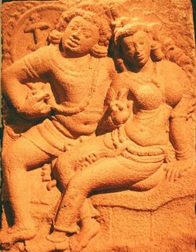
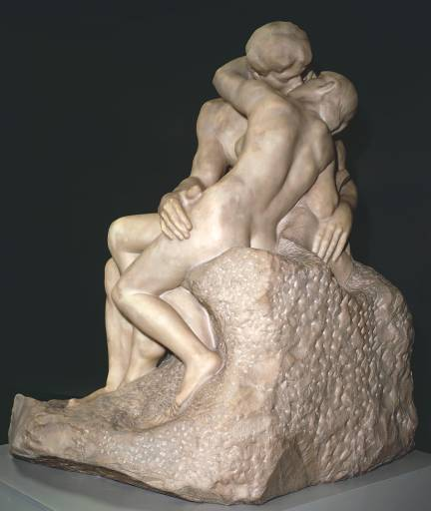
Human Reproduction
The kiss
Auguste Rodin
1886

Slide 4
The female reproductive cycle
From menarche (start of menstrual periods) to the menopause (end of menstruation)
Cycle lasts around 28 days
  varies from 20-45 days
Ovary dictates the cycle
Changes in endometrium recognized as menstrual cycle
Day 1 of cycle: first day of menstruation

Slide 5
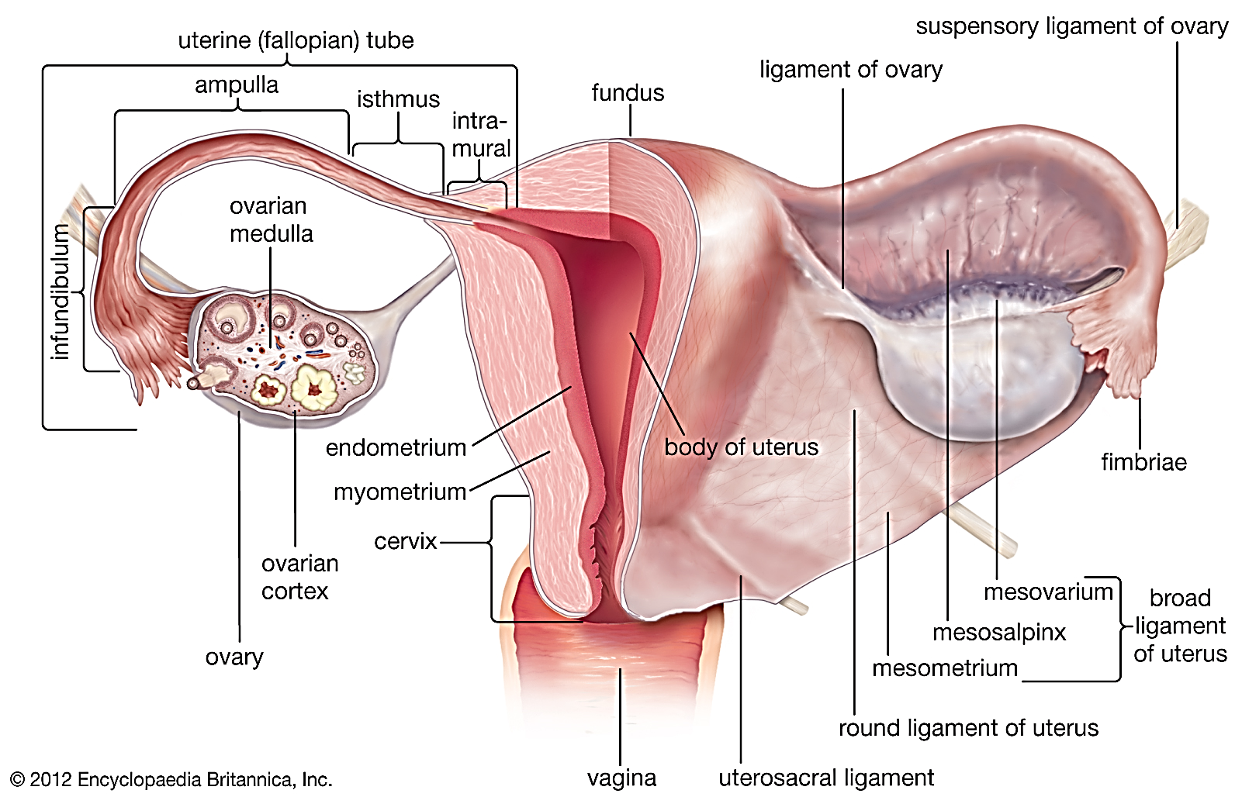

Slide 6
What happens in the ovary during a female cycle?
Ovulation
release of one
egg
from ovary
Providing hormonal support for pregnancy
"Luteal phase"
Development of egg in ovary
"Follicular phase"
1
14
28
Day 1-3
Menstruation
Always 14 days

Slide 7
Quick revision: formation of oocytes (eggs)
When do a woman’s oocytes start to form?
What form of cell division occurs?
What happens to this cell division?
What happens to the forming oocytes during life?

Slide 8
The ovarian cycle
Follicular phase
  Development of a follicle
  Oestrogen levels rise
Ovulation
  Release of oocyte from ovary
Luteal phase
  Corpus luteum secretes progesterone & oestrogen

Slide 9
Follicular phase
Develops around 6-12 follicles at each cycle
Follicle stimulating hormone (FSH) regulates this
D 6- one follicle enlarges to becomes dominant follicle (rest all die)
Maturing follicle called Graafian follicle
Follicle releases OESTROGEN
  Oestrogen from granulosa cells and theca interna
  Secreted to antrum & blood

Slide 10
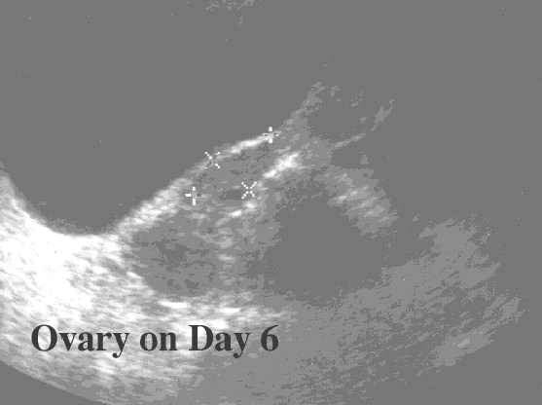
Ovary
Dominant follicle

Slide 11
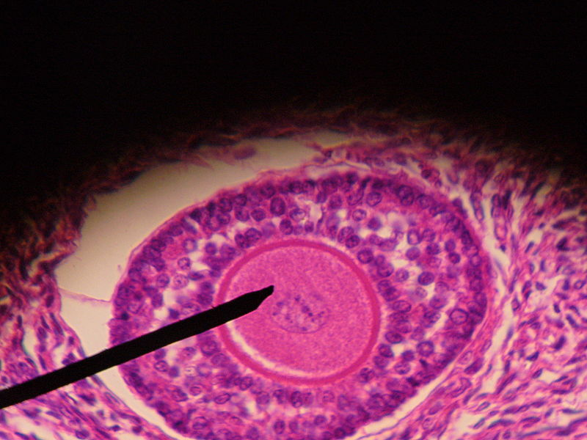
Graafian Follicle

Slide 12
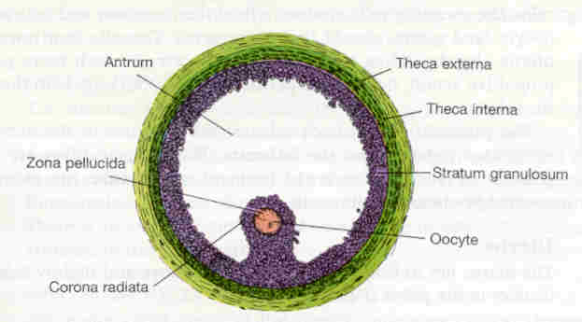
Graafian Follicle
Theca Externa
Antrum
Theca Interna
Zona
pellucida
Stratum
granulosum
Oocyte
Corona
Radiata

Slide 13
Release of egg "Ovulation"
Follicle ruptures (breaks up)
Oocyte released with surrounding zona pellucida & layer of granulosa cells “cumulus oophorus”
Meiosis 1 completed forming 2ry oocyte and 1st polar body
Released egg enters fallopian tube

Slide 14
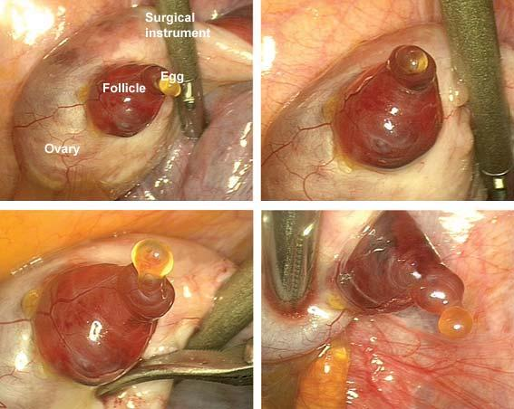
Ovulation

Slide 15
Luteal phase
Remainder of follicle forms corpus luteum
Granulosa cells proliferate to form lutein cells
This secretes PROGESTERONE & Oestrogen
If no fertilisation happens- corpus luteum starts dying after about 10 days
The hormone production starts to reduce

Slide 16
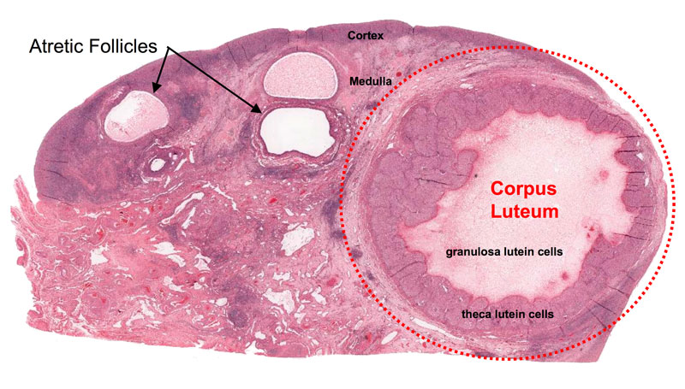
Corpus Luteum
Granulosa cells
Theca cells

Slide 17
What happens in the uterus?
Endometrium (stratum functionale) regrows
"Proliferative phase"
Endometrium secretes substances able to feed growing embryo
"Secretory phase"
1
Oestrogen effect
14
Progesterone &
Oestrogen effects
28
Day 1-3
Menstruation

Slide 18
Proliferative Phase
Around day 6-14 (of a 28 day cycle)
Regrowth of stratum functionale (epithelium, glands and stroma)
Oestrogen stimulates this
Variable length

Slide 19
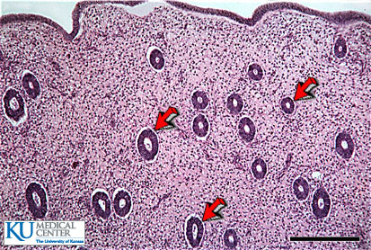
Proliferative Endometrium

Slide 20
Secretory phase
Uterine glands filled with secretions
Arteries coiled
Under influence of progesterone

Slide 21
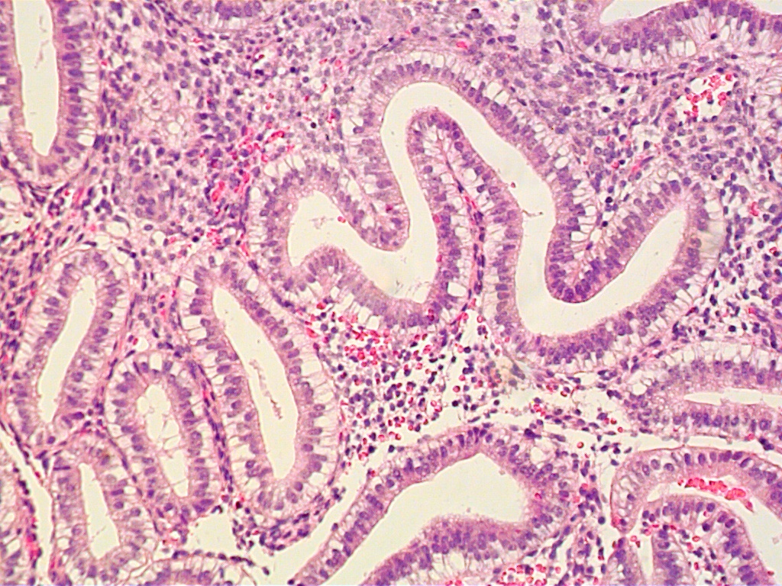
Secretory Endometrium

Slide 22
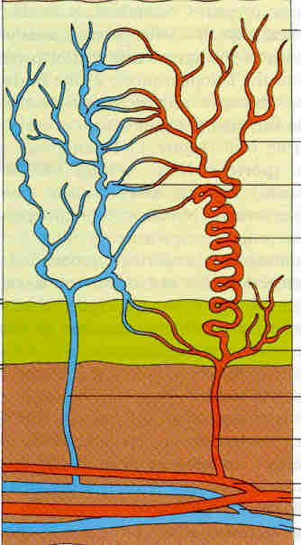
Menstruation
Lasts from 3-5 days (varies from 1-8d)
Loses superficial 2/3 of endometrium (stratum functionale) and blood
Blood loss of around 30 mL
>80mL abnormal ‘menorrhagia’

Slide 23
Menstruation
Mainly arterial blood (75%) & tissue debris, prostaglandins, fibrinolysin (prevents clot formation normally)
Corpus luteum regression causes loss of hormones → thinning / necrosis of endometrium
Arterial spasm and damage to coiled arteries → bleeding
Prostaglandin [PGF2α] increase spasm

Slide 24
Other events in the uterus
Follicular phase
(Oestrogen)
Luteal phase
(Progesterone)
Muscle
"Myometrium"
Increased
contractility
Reduced
contractility
Cervix
(Neck of womb)
Thin secretions
Spread to fernlike pattern
Thick secretions
Absent fernlike pattern

Slide 25
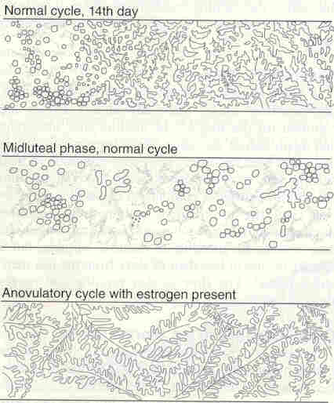
Fern like pattern

Slide 26
Changes in vagina and breast
    Vagina
Proliferative phase:
  Cornified epithelium
Secretory phase:
  Thick secretions
    Breast
Proliferative phase:
  Increase in ductal tissue
Secretory phase:
  Increase in lobular/ alveolar proliferation

Slide 27
Indicators of ovulation (progesterone effects)
Rise in basal body temp 0.5°C
Absent fernlike pattern of cervical mucus
Rise in progesterone level (peak about 10 days after ovulation)
Secretory endometrium
Anovular cycles
  Can be physiological
  Menstrual pattern- irregular, variable blood loss

Slide 28
True or false regarding a woman with 33 day regular menstrual cycles?
Menstrual bleeding lasting 5 days is normal
On day 22, her ovary is in its follicular phase
Ovulation is on day 19
Her progesterone level declines after day 29
A fernlike pattern of her cervical secretions is indicative of ovulation

Slide 29
At the end of these lectures you should be able to
Describe the changes in the ovary during the female menstrual cycle (follicular phase, ovulation, luteal phase)
Calculate the duration of each phase
Using a clearly labeled diagram, explain the hormonal changes that occur during each phase including the events leading to ovulation
Outline the events occurring in the uterus (menstruation, proliferation and secretory phases) & state the relationship between ovarian and uterine phases
Outline the role of oestrogen and progesterone on the endometrium, myometrium, cervix, vagina, breast and the systemic effects of oestrogens

Slide 30
Hormonal changes
Follicular phase
Luteal phase
Oestrogen
Progesterone
Luteinizing hormone
Follicle stimulating
hormone

Slide 31
Becoming sexually mature
Puberty - Stage at which the gonads able to produce gametes and hormones
Adolescence - Stage of development between childhood and puberty
Development of reproductive organs and secondary sexual characteristics (e.g. pubic hair, breasts)
Menarche: onset of the first menstrual period

Slide 32
Menopause
Permanent disappearance of menstrual cycles
Decline in numbers of primordial follicles
Main problems are related to oestrogen deficiency

Slide 33
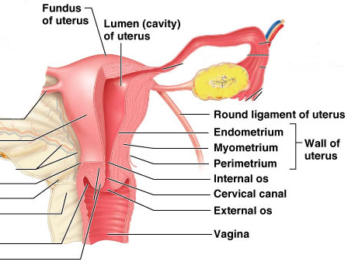

Slide 34
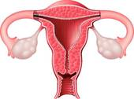
Fallopian
tube
Myometrium
Ovary
Cervix
Endometrium
Vagina

